Slide 1

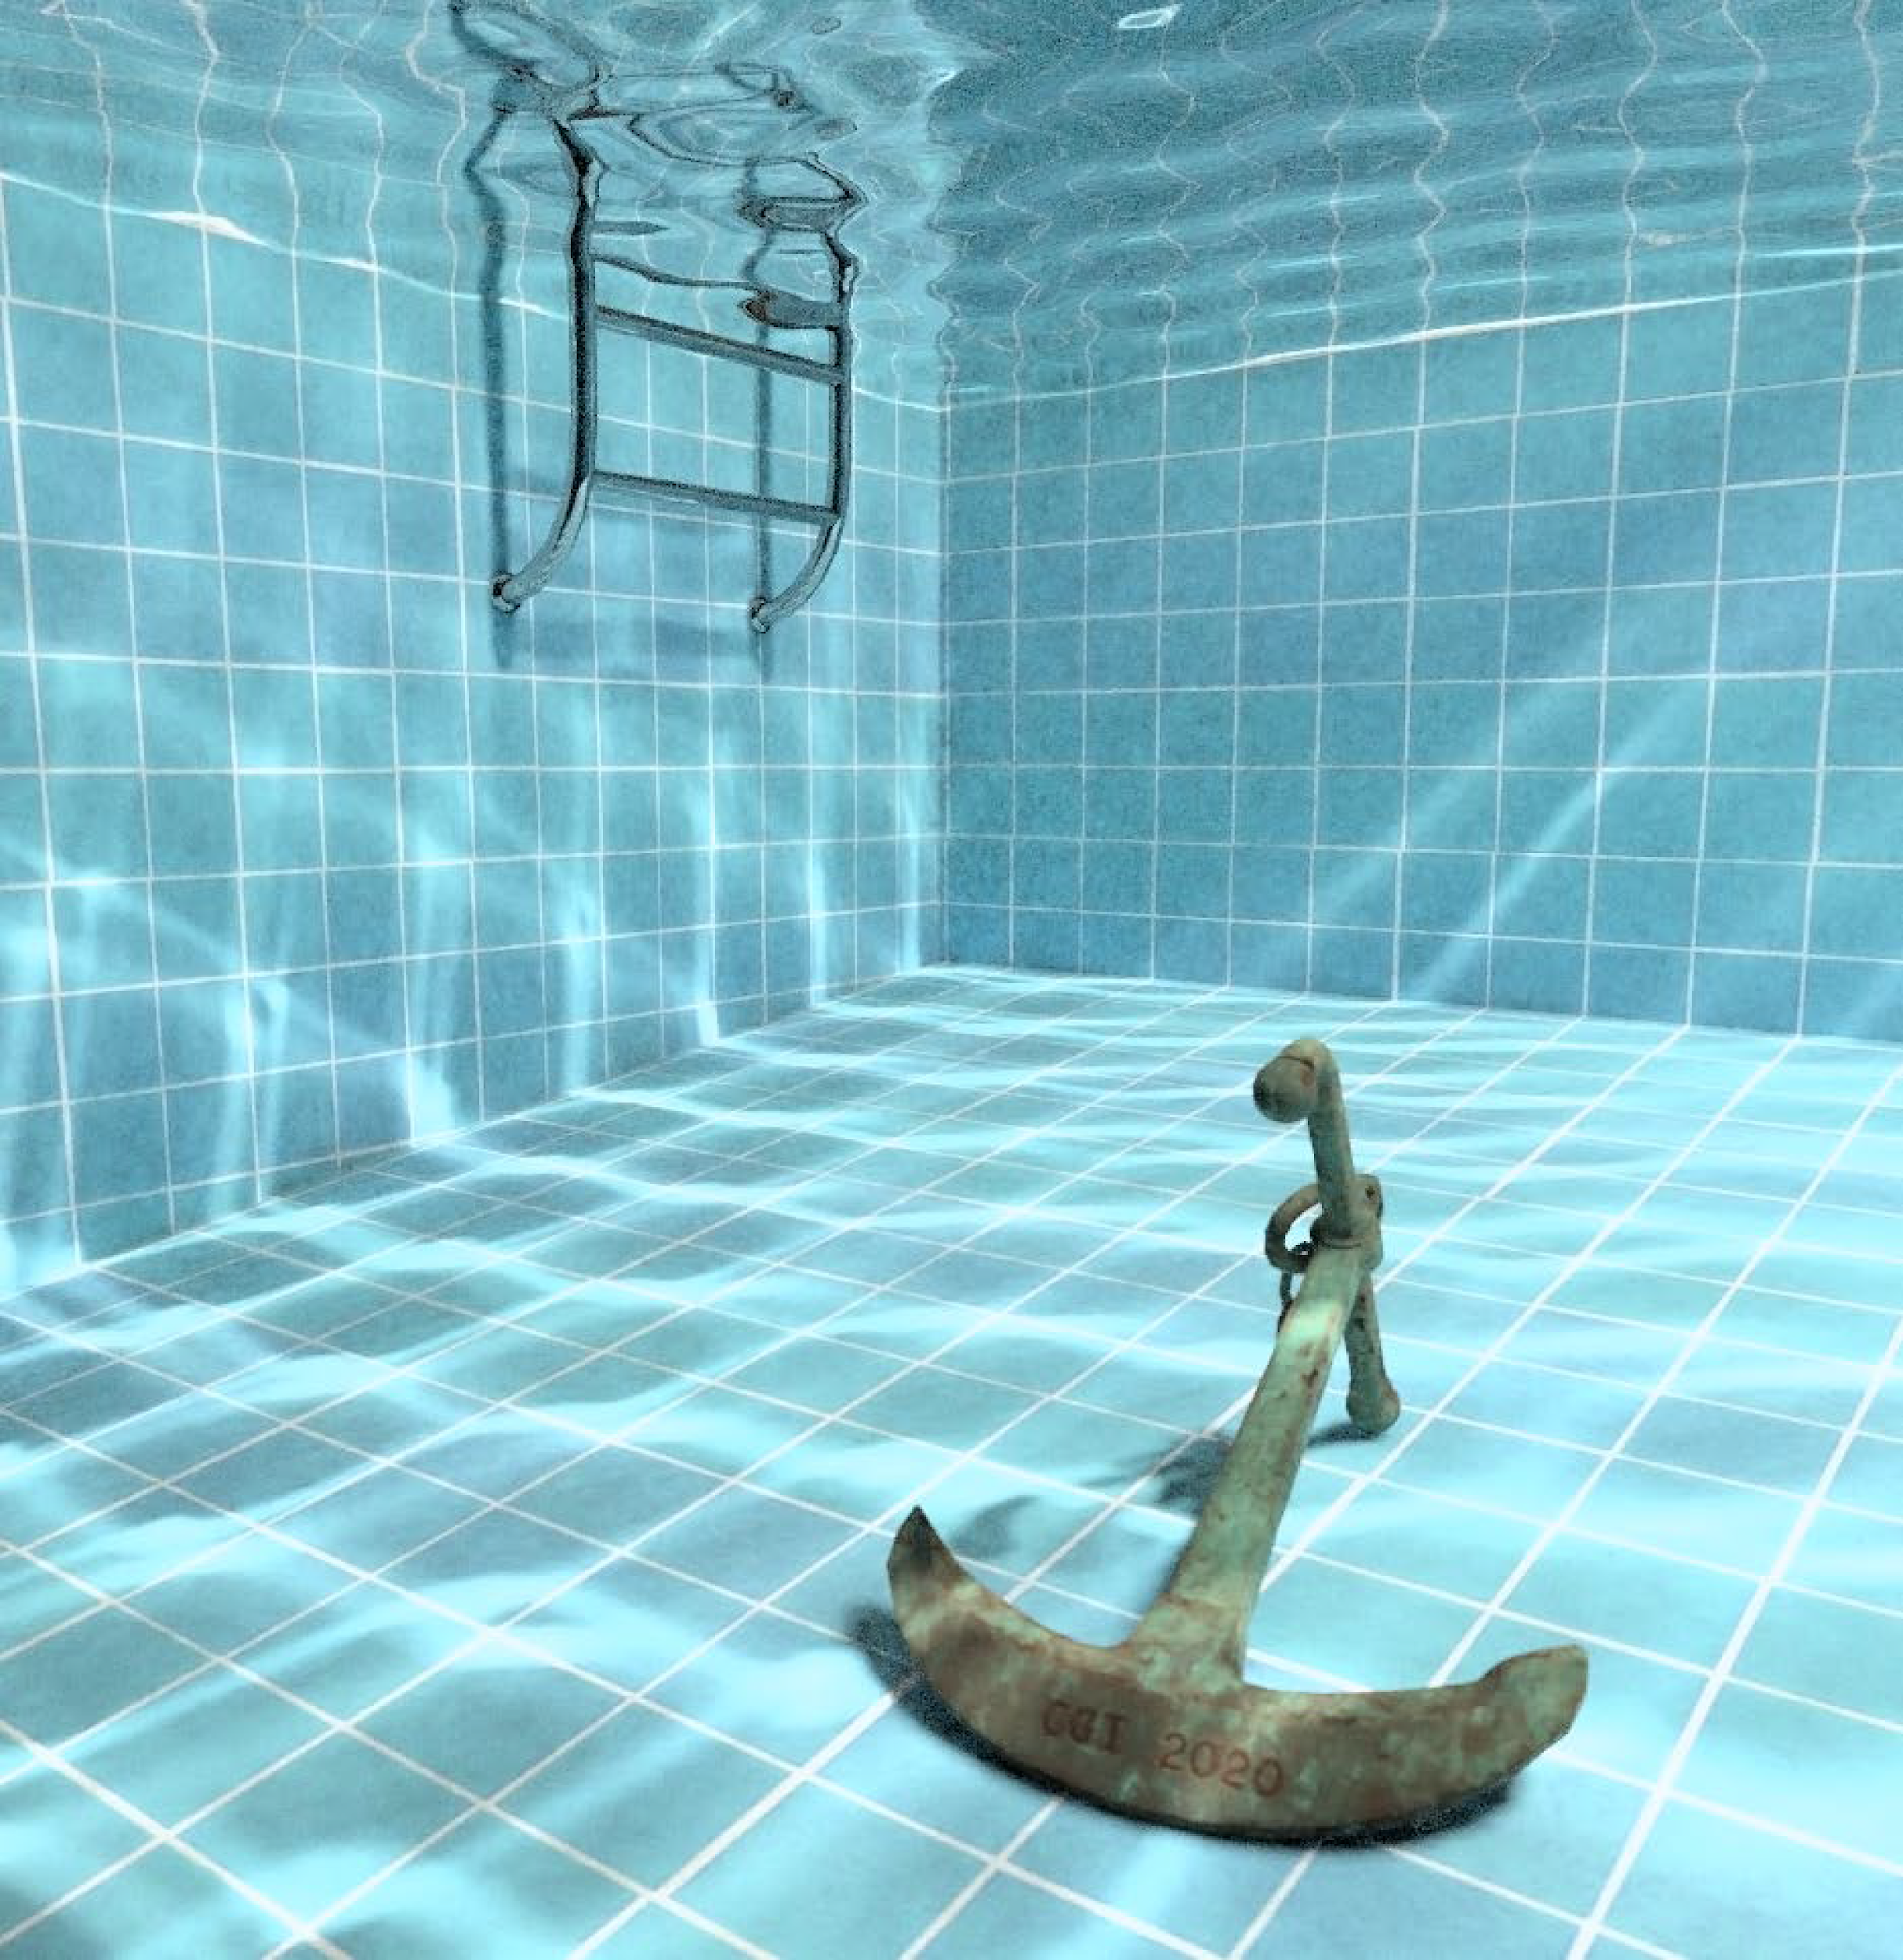

Rasterisation-based
Progressive Photon Mapping
I. Evangelou
G. Papaioannou
K. Vardis
A. A. Vasilakis
Department of Informatics,
Athens University of Economics and Business,
Greece
Notes:
Hello, my name is Iordanis Evangelou, I am a PhD student at Athens University of Economics and Business and this is a presentation of our work on rasterisation-based Progressive Photon Mapping.

Slide 2
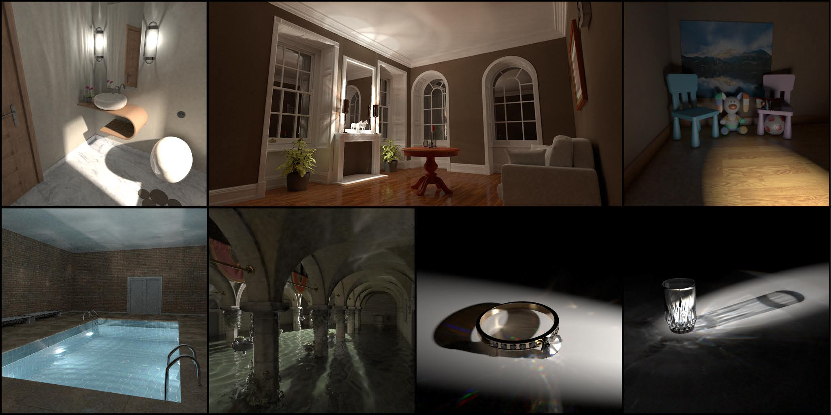
Introduction
2
Notes:
Rendering high fidelity images, is a challenging task when difficult to capture illumination events are present in the scene.
One such case arises, when we would like to simulate lighting phenomena such as the caustic effects.
To handle these type of events, the photon mapping algorithm and several of its variants have been extensively studied in computer graphics.

Slide 3
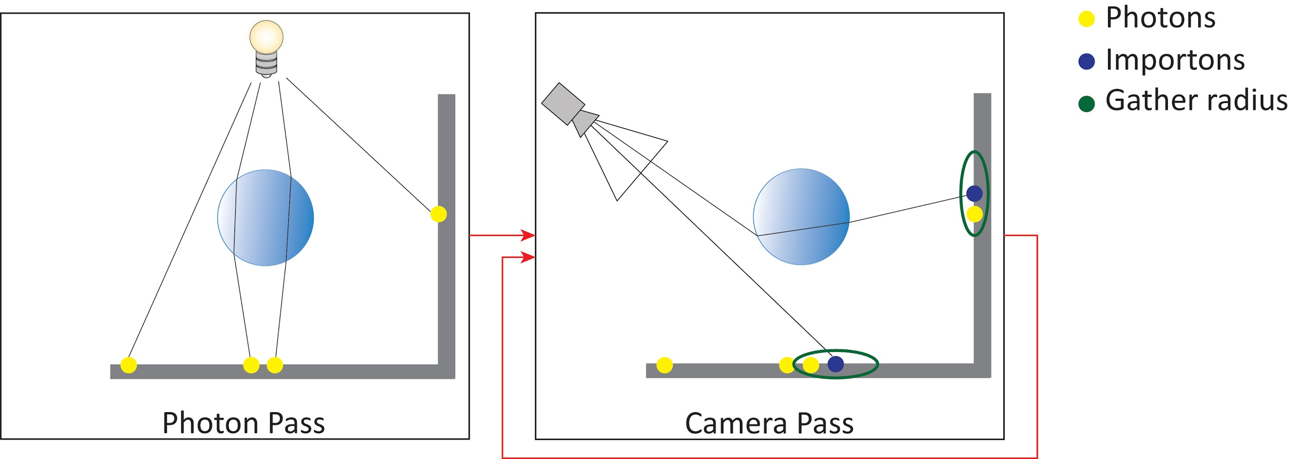
Photon Mapping [Jen96]
3
Notes:
The bidirectional approach of photon mapping was first introduced by Jensen and consists of two main steps.
First, a massive number of photons are emitted from the light sources, traced throughout the scene, depositing their flux contribution to certain light events.
Then, in the second step, paths traced from the camera gather a fixed number of photons in the local neighborhood around diffuse events.
As the number of emitted photons tends to infinity, the photon mapping algorithm can produce accurate output radiance estimates.
In practice though, the generation of converged images requires a very large amount of photons, resulting in large storage and indexing requirements.

Slide 4
Photon Mapping [Jen96]
1st step → trace and store photons once
4
Notes:
The bidirectional approach of photon mapping was first introduced by Jensen and consists of two main steps.
First, a massive number of photons are emitted from the light sources, traced throughout the scene, depositing their flux contribution to certain light events.
Then, in the second step, paths traced from the camera gather a fixed number of photons in the local neighborhood around diffuse events.
As the number of emitted photons tends to infinity, the photon mapping algorithm can produce accurate output radiance estimates.
In practice though, the generation of converged images requires a very large amount of photons, resulting in large storage and indexing requirements.

Slide 5
Photon Mapping [Jen96]
1st step → trace and store photons once
2nd step → iteratively trace camera rays (importons)
and gather photons to estimate output radiance
5
Notes:
The bidirectional approach of photon mapping was first introduced by Jensen and consists of two main steps.
First, a massive number of photons are emitted from the light sources, traced throughout the scene, depositing their flux contribution to certain light events.
Then, in the second step, paths traced from the camera gather a fixed number of photons in the local neighborhood around diffuse events.
As the number of emitted photons tends to infinity, the photon mapping algorithm can produce accurate output radiance estimates.
In practice though, the generation of converged images requires a very large amount of photons, resulting in large storage and indexing requirements.

Slide 6
Photon Mapping [Jen96]
1st step → trace and store photons once
2nd step → iteratively trace camera rays (importons)
and gather photons to estimate output radiance
Order of 10⁵-10⁷ photons → storage/indexing/query overhead
6
Notes:
The bidirectional approach of photon mapping was first introduced by Jensen and consists of two main steps.
First, a massive number of photons are emitted from the light sources, traced throughout the scene, depositing their flux contribution to certain light events.
Then, in the second step, paths traced from the camera gather a fixed number of photons in the local neighborhood around diffuse events.
As the number of emitted photons tends to infinity, the photon mapping algorithm can produce accurate output radiance estimates.
In practice though, the generation of converged images requires a very large amount of photons, resulting in large storage and indexing requirements.

Slide 7
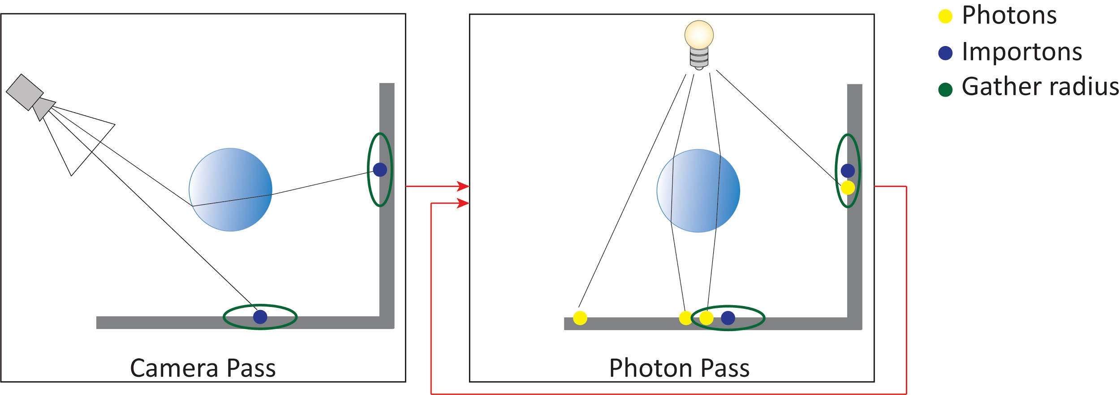
Progressive Photon Mapping (PPM) [HOJ08]
7
Notes:
For this reason, Hachisuka et al. further refined the algorithm in order to lift the prohibitive cost induced from the photon storage.
In contrast to the original method, the camera path tracing pass, is invoked first, storing a number of “importons” dependent only on the image resolution, which represent the hit points, where photon gathering is going to occur.
Then, photons are iteratively emitted in batches and traced, contributing to the stored importons in each iteration. This iterative photon emission process, allows for arbitrarily large populations of photons. Coupled with a statistical shrinking of the photon gathering radius, the proposed mechanism ensures a high-quality and consistent output, with a low memory footprint.
[It is difficult to talk here about rebuilding of data structures, as in theory, photons are not stored, but rather directly index the importon map, which remains constant through the photon emission. You do not need a photon map.]

Slide 8
Progressive Photon Mapping (PPM) [HOJ08]
1st step → trace and store importons once
8
Notes:
For this reason, Hachisuka et al. further refined the algorithm in order to lift the prohibitive cost induced from the photon storage.
In contrast to the original method, the camera path tracing pass, is invoked first, storing a number of “importons” dependent only on the image resolution, which represent the hit points, where photon gathering is going to occur.
Then, photons are iteratively emitted in batches and traced, contributing to the stored importons in each iteration. This iterative photon emission process, allows for arbitrarily large populations of photons. Coupled with a statistical shrinking of the photon gathering radius, the proposed mechanism ensures a high-quality and consistent output, with a low memory footprint.
[It is difficult to talk here about rebuilding of data structures, as in theory, photons are not stored, but rather directly index the importon map, which remains constant through the photon emission. You do not need a photon map.]

Slide 9
Progressive Photon Mapping (PPM) [HOJ08]
1st step → trace and store importons once
2nd step → iteratively trace photon batches
9
Notes:
For this reason, Hachisuka et al. further refined the algorithm in order to lift the prohibitive cost induced from the photon storage.
In contrast to the original method, the camera path tracing pass, is invoked first, storing a number of “importons” dependent only on the image resolution, which represent the hit points, where photon gathering is going to occur.
Then, photons are iteratively emitted in batches and traced, contributing to the stored importons in each iteration. This iterative photon emission process, allows for arbitrarily large populations of photons. Coupled with a statistical shrinking of the photon gathering radius, the proposed mechanism ensures a high-quality and consistent output, with a low memory footprint.
[It is difficult to talk here about rebuilding of data structures, as in theory, photons are not stored, but rather directly index the importon map, which remains constant through the photon emission. You do not need a photon map.]

Slide 10
Progressive Photon Mapping (PPM) [HOJ08]
1st step → trace and store importons once
2nd step → iteratively trace photon batches
And distribute photons within importon radius
10
Notes:
For this reason, Hachisuka et al. further refined the algorithm in order to lift the prohibitive cost induced from the photon storage.
In contrast to the original method, the camera path tracing pass, is invoked first, storing a number of “importons” dependent only on the image resolution, which represent the hit points, where photon gathering is going to occur.
Then, photons are iteratively emitted in batches and traced, contributing to the stored importons in each iteration. This iterative photon emission process, allows for arbitrarily large populations of photons. Coupled with a statistical shrinking of the photon gathering radius, the proposed mechanism ensures a high-quality and consistent output, with a low memory footprint.
[It is difficult to talk here about rebuilding of data structures, as in theory, photons are not stored, but rather directly index the importon map, which remains constant through the photon emission. You do not need a photon map.]

Slide 11
Progressive Photon Mapping (PPM) [HOJ08]
1st step → trace and store importons once
2nd step → iteratively trace photon batches
And distribute photons within importon radius
After 2nd step → shrink radius and update local statistics
11
Notes:
For this reason, Hachisuka et al. further refined the algorithm in order to lift the prohibitive cost induced from the photon storage.
In contrast to the original method, the camera path tracing pass, is invoked first, storing a number of “importons” dependent only on the image resolution, which represent the hit points, where photon gathering is going to occur.
Then, photons are iteratively emitted in batches and traced, contributing to the stored importons in each iteration. This iterative photon emission process, allows for arbitrarily large populations of photons. Coupled with a statistical shrinking of the photon gathering radius, the proposed mechanism ensures a high-quality and consistent output, with a low memory footprint.
[It is difficult to talk here about rebuilding of data structures, as in theory, photons are not stored, but rather directly index the importon map, which remains constant through the photon emission. You do not need a photon map.]

Slide 12
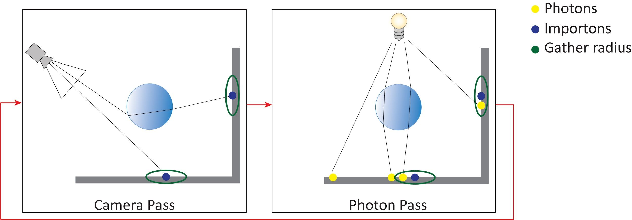
Stochastic / Probabilistic PPM [HJ09,KZ11]
12
Notes:
The former method, was further improved independently by Hachisuka and Jensen as well as Knaus and Zwicker that unified both the camera and the light stages.
This effectively improved the overall convergence for certain illumination effects and greatly simplified several aspects of the algorithm.
Instead of relying on local statistics at each importon for the constriction of the gathering radius, now, a global rate is estimated, which allows for a more flexible exploration of the path space by stochastically computing new importons per iteration.
It is here that we must mention the ADS rebuilt, since now, you can disassociate the camera paths from local statistics and you can re-generate importons per iteration (which further need some storage and ADS on top of them):
However, this comes at the cost of requiring either an importon or a photon index to be rebuilt per iteration, for performing the nearest neighbor search during photon density estimation.
Our presented work, uses the probabilistic approach of the progressive photon mapper proposed by Knaus and Zwicker.
This effectively reduced the variance for certain illumination effects and greatly simplified several aspects of the algorithm.
Instead of relying on local statistics at each importon for the constriction of the gathering radius, a global rate is used for the entire scene.
Additionally, the importon generation step is now performed in an iterative fashion, allowing for a more flexible exploration of the path space, by stochastically computing new importons per iteration.
However, this comes at the cost of requiring either an importon or a photon index to be rebuilt per iteration, to perform nearest neighbor search, during photon density estimation.

Slide 13
Stochastic / Probabilistic PPM [HJ09,KZ11]
Iteratively trace and store importons and photons
13
Notes:
The former method, was further improved independently by Hachisuka and Jensen as well as Knaus and Zwicker that unified both the camera and the light stages.
This effectively improved the overall convergence for certain illumination effects and greatly simplified several aspects of the algorithm.
Instead of relying on local statistics at each importon for the constriction of the gathering radius, now, a global rate is estimated, which allows for a more flexible exploration of the path space by stochastically computing new importons per iteration.
It is here that we must mention the ADS rebuilt, since now, you can disassociate the camera paths from local statistics and you can re-generate importons per iteration (which further need some storage and ADS on top of them):
However, this comes at the cost of requiring either an importon or a photon index to be rebuilt per iteration, for performing the nearest neighbor search during photon density estimation.
Our presented work, uses the probabilistic approach of the progressive photon mapper proposed by Knaus and Zwicker.
This effectively reduced the variance for certain illumination effects and greatly simplified several aspects of the algorithm.
Instead of relying on local statistics at each importon for the constriction of the gathering radius, a global rate is used for the entire scene.
Additionally, the importon generation step is now performed in an iterative fashion, allowing for a more flexible exploration of the path space, by stochastically computing new importons per iteration.
However, this comes at the cost of requiring either an importon or a photon index to be rebuilt per iteration, to perform nearest neighbor search, during photon density estimation.

Slide 14
Stochastic / Probabilistic PPM [HJ09,KZ11]
Iteratively trace and store importons and photons
Build either importon or photon index (in every iteration)
14
Notes:
The former method, was further improved independently by Hachisuka and Jensen as well as Knaus and Zwicker that unified both the camera and the light stages.
This effectively improved the overall convergence for certain illumination effects and greatly simplified several aspects of the algorithm.
Instead of relying on local statistics at each importon for the constriction of the gathering radius, now, a global rate is estimated, which allows for a more flexible exploration of the path space by stochastically computing new importons per iteration.
It is here that we must mention the ADS rebuilt, since now, you can disassociate the camera paths from local statistics and you can re-generate importons per iteration (which further need some storage and ADS on top of them):
However, this comes at the cost of requiring either an importon or a photon index to be rebuilt per iteration, for performing the nearest neighbor search during photon density estimation.
Our presented work, uses the probabilistic approach of the progressive photon mapper proposed by Knaus and Zwicker.
This effectively reduced the variance for certain illumination effects and greatly simplified several aspects of the algorithm.
Instead of relying on local statistics at each importon for the constriction of the gathering radius, a global rate is used for the entire scene.
Additionally, the importon generation step is now performed in an iterative fashion, allowing for a more flexible exploration of the path space, by stochastically computing new importons per iteration.
However, this comes at the cost of requiring either an importon or a photon index to be rebuilt per iteration, to perform nearest neighbor search, during photon density estimation.

Slide 15
Stochastic / Probabilistic PPM [HJ09,KZ11]
Iteratively trace and store importons and photons
Build either importon or photon index (in every iteration)
Distribute/Gather photons
After each iteration shrink radius and update statistics
15
Notes:
The former method, was further improved independently by Hachisuka and Jensen as well as Knaus and Zwicker that unified both the camera and the light stages.
This effectively improved the overall convergence for certain illumination effects and greatly simplified several aspects of the algorithm.
Instead of relying on local statistics at each importon for the constriction of the gathering radius, now, a global rate is estimated, which allows for a more flexible exploration of the path space by stochastically computing new importons per iteration.
It is here that we must mention the ADS rebuilt, since now, you can disassociate the camera paths from local statistics and you can re-generate importons per iteration (which further need some storage and ADS on top of them):
However, this comes at the cost of requiring either an importon or a photon index to be rebuilt per iteration, for performing the nearest neighbor search during photon density estimation.
Our presented work, uses the probabilistic approach of the progressive photon mapper proposed by Knaus and Zwicker.
This effectively reduced the variance for certain illumination effects and greatly simplified several aspects of the algorithm.
Instead of relying on local statistics at each importon for the constriction of the gathering radius, a global rate is used for the entire scene.
Additionally, the importon generation step is now performed in an iterative fashion, allowing for a more flexible exploration of the path space, by stochastically computing new importons per iteration.
However, this comes at the cost of requiring either an importon or a photon index to be rebuilt per iteration, to perform nearest neighbor search, during photon density estimation.

Slide 16
Motivation
Progressive variants of photon mapping requires:
low memory footprint
16
Notes:
To recap, the most recently proposed progressive variants of photon mapping, require a constant and relatively low amount of memory at the cost of reconstructing the photon or importon hierarchy in every subsequent iteration.

Slide 17
Motivation
Progressive variants of photon mapping requires:
low memory footprint
reconstruction of the importon/photon map at every iteration
17
Notes:
To recap, the most recently proposed progressive variants of photon mapping, require a constant and relatively low amount of memory at the cost of reconstructing the photon or importon hierarchy in every subsequent iteration.

Slide 18
Motivation
Progressive variants of photon mapping requires:
low memory footprint
reconstruction of the importon/photon map at every iteration
Traditionally handled by hierarchical data structures such as kd-trees:
efficient queries
18
Notes:
Traditionally, the indexing mechanism is handled by some hierarchical data structure such as a kd-tree, which provides efficient queries at the cost of a slow construction time.
This can induce a prohibitive cost to the overall process in terms of application interactivity and responsiveness which in turn makes its practical usage limited.
Ideally, our indexing scheme should rank both properties equally.

Slide 19
Motivation
Progressive variants of photon mapping requires:
low memory footprint
reconstruction of the importon/photon map at every iteration
Traditionally handled by hierarchical data structures such as kd-trees:
efficient queries
slow construction time
19
Notes:
Traditionally, the indexing mechanism is handled by some hierarchical data structure such as a kd-tree, which provides efficient queries at the cost of a slow construction time.
This can induce a prohibitive cost to the overall process in terms of application interactivity and responsiveness which in turn makes its practical usage limited.
Ideally, our indexing scheme should rank both properties equally.

Slide 20
Motivation
Progressive variants of photon mapping requires:
low memory footprint
reconstruction of the importon/photon map at every iteration
Traditionally handled by hierarchical data structures such as kd-trees:
efficient queries
slow construction time
We can exploit rasterization for photon distribution since:
Is ubiquitous
Is independent of GPU architecture
20
Notes:
Taking these factors into consideration and by exploiting an ubiquitous pipeline that is independent of the GPU architecture such as the rasterization pipeline,
the hierarchy construction can be replaced with a highly parallel process in order to resolve the gathering step but at the same time maintain query performance.

Slide 21
Motivation
Progressive variants of photon mapping requires:
low memory footprint
reconstruction of the importon/photon map at every iteration
Traditionally handled by hierarchical data structures such as kd-trees:
efficient queries
slow construction time
We can exploit rasterization for photon distribution since:
Is ubiquitous
Is independent of GPU architecture
Replaces hierarchy construction
Can deliver comparable query performance
21
Notes:
Taking these factors into consideration and by exploiting an ubiquitous pipeline that is independent of the GPU architecture such as the rasterization pipeline,
the hierarchy construction can be replaced with a highly parallel process in order to resolve the gathering step but at the same time maintain query performance.

Slide 22
Contributions
22
Notes:
Consequently, in this work we focus on unifying both tracing and photon energy distribution stages under the hood of the rasterization pipeline.
This will enable us to implicitly couple the importon storage with the tracing architecture and fully utilize splatting operation, a highly parallel process to effectively distribute photon energy flux.
As a result, construction of a photon hierarchy can be completely omitted.
This is in sharp contrast to prior rasterisation-based approaches as our method, is the first to demonstrate a faithful and accurate porting of probabilistic progressive photon mapping that captures every illumination event.

Slide 23
Contributions
Unify tracing and photon gathering under the rasterisation pipeline
23
Notes:
Consequently, in this work we focus on unifying both tracing and photon energy distribution stages under the hood of the rasterization pipeline.
This will enable us to implicitly couple the importon storage with the tracing architecture and fully utilize splatting operation, a highly parallel process to effectively distribute photon energy flux.
As a result, construction of a photon hierarchy can be completely omitted.
This is in sharp contrast to prior rasterisation-based approaches as our method, is the first to demonstrate a faithful and accurate porting of probabilistic progressive photon mapping that captures every illumination event.

Slide 24
Contributions
Unify tracing and photon gathering under the rasterisation pipeline
Exploitation of a single data structure for both tracing and importon storage
24
Notes:
Consequently, in this work we focus on unifying both tracing and photon energy distribution stages under the hood of the rasterization pipeline.
This will enable us to implicitly couple the importon storage with the tracing architecture and fully utilize splatting operation, a highly parallel process to effectively distribute photon energy flux.
As a result, construction of a photon hierarchy can be completely omitted.
This is in sharp contrast to prior rasterisation-based approaches as our method, is the first to demonstrate a faithful and accurate porting of probabilistic progressive photon mapping that captures every illumination event.

Slide 25
Contributions
Unify tracing and photon gathering under the rasterisation pipeline
Exploitation of a single data structure for both tracing and importon storage
Extensive exploitation of splatting to maximise efficiency
25
Notes:
Consequently, in this work we focus on unifying both tracing and photon energy distribution stages under the hood of the rasterization pipeline.
This will enable us to implicitly couple the importon storage with the tracing architecture and fully utilize splatting operation, a highly parallel process to effectively distribute photon energy flux.
As a result, construction of a photon hierarchy can be completely omitted.
This is in sharp contrast to prior rasterisation-based approaches as our method, is the first to demonstrate a faithful and accurate porting of probabilistic progressive photon mapping that captures every illumination event.

Slide 26
Contributions
Unify tracing and photon gathering under the rasterisation pipeline
Exploitation of a single data structure for both tracing and importon storage
Extensive exploitation of splatting to maximise efficiency
Elimination of the photon map hierarchy
26
Notes:
Consequently, in this work we focus on unifying both tracing and photon energy distribution stages under the hood of the rasterization pipeline.
This will enable us to implicitly couple the importon storage with the tracing architecture and fully utilize splatting operation, a highly parallel process to effectively distribute photon energy flux.
As a result, construction of a photon hierarchy can be completely omitted.
This is in sharp contrast to prior rasterisation-based approaches as our method, is the first to demonstrate a faithful and accurate porting of probabilistic progressive photon mapping that captures every illumination event.

Slide 27
Contributions
Unify tracing and photon gathering under the rasterisation pipeline
Exploitation of a single data structure for both tracing and importon storage
Extensive exploitation of splatting to maximise efficiency
Elimination of the photon map hierarchy
In contrast to prior rasterisation-based approaches, our method:
Is a faithful and accurate porting of probabilistic PPM
Captures every illumination event
27
Notes:
Consequently, in this work we focus on unifying both tracing and photon energy distribution stages under the hood of the rasterization pipeline.
This will enable us to implicitly couple the importon storage with the tracing architecture and fully utilize splatting operation, a highly parallel process to effectively distribute photon energy flux.
As a result, construction of a photon hierarchy can be completely omitted.
This is in sharp contrast to prior rasterisation-based approaches as our method, is the first to demonstrate a faithful and accurate porting of probabilistic progressive photon mapping that captures every illumination event.

Slide 28
Image-based data structures [VVP20]
28
Notes:
Before we delve into the details of our method, it is essential to get a high level overview of some basic rasterization data structures.

Slide 29
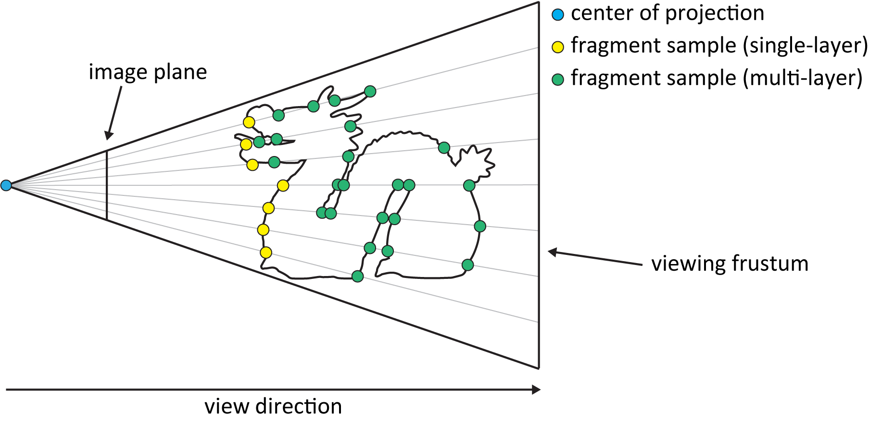
Image-based data structures [VVP20]
29
Notes:
Image-based data structures, are specialized in capturing view-dependent geometry samples at a predefined granularity, corresponding to the image plane resolution in pixel units.
Projected samples generate fragments that may overlap in image space

Slide 30
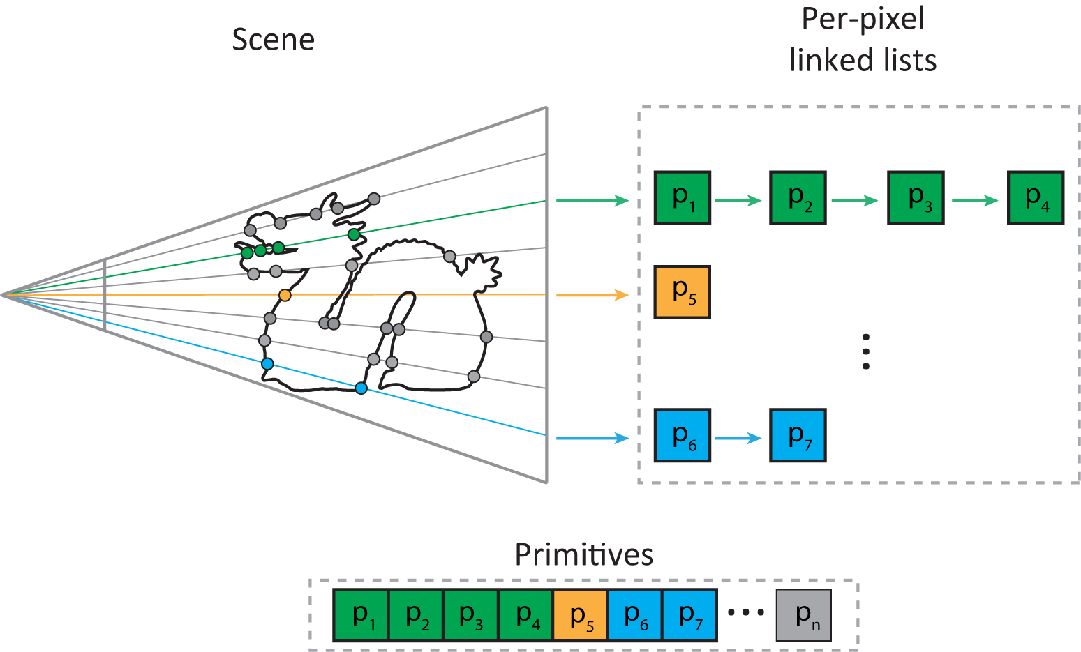
Image-based data structures [VVP20]
30
Notes:
and thus, require a per-pixel storage mechanism to maintain.
Therefore, these fragments can be directly used to index the actual primitives of the scene.

Slide 31
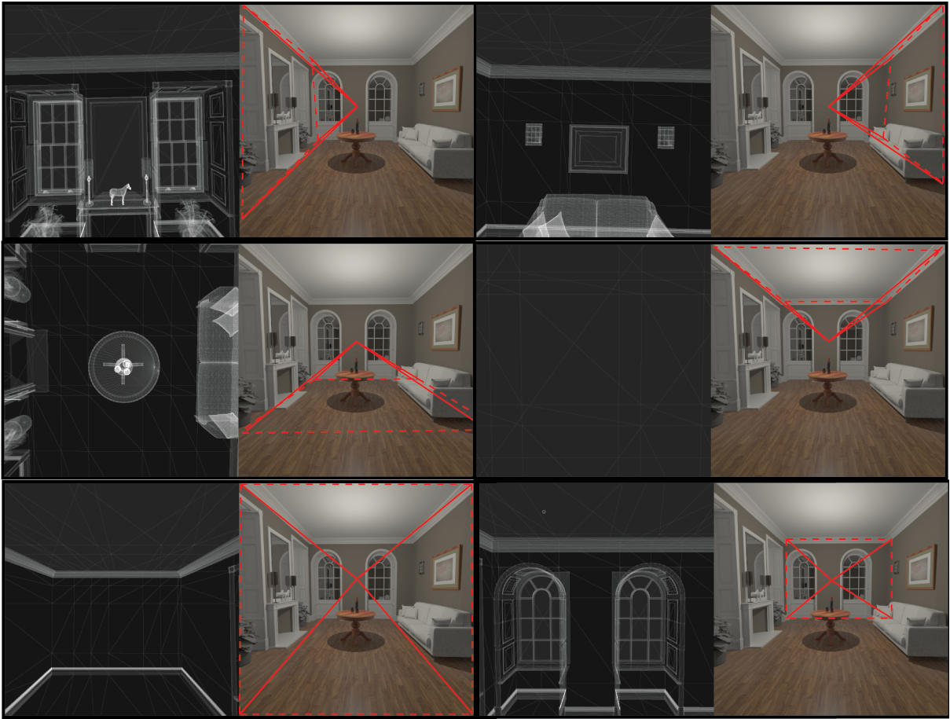
Image-based data structures [VVP20]
31
Notes:
By appropriately extending a single view to a multi view scheme we can effectively index the whole input geometry.
In the special case of a perspective projection one can achieve this by constructing six partially overlapping views in a cubemap formation.

Slide 32
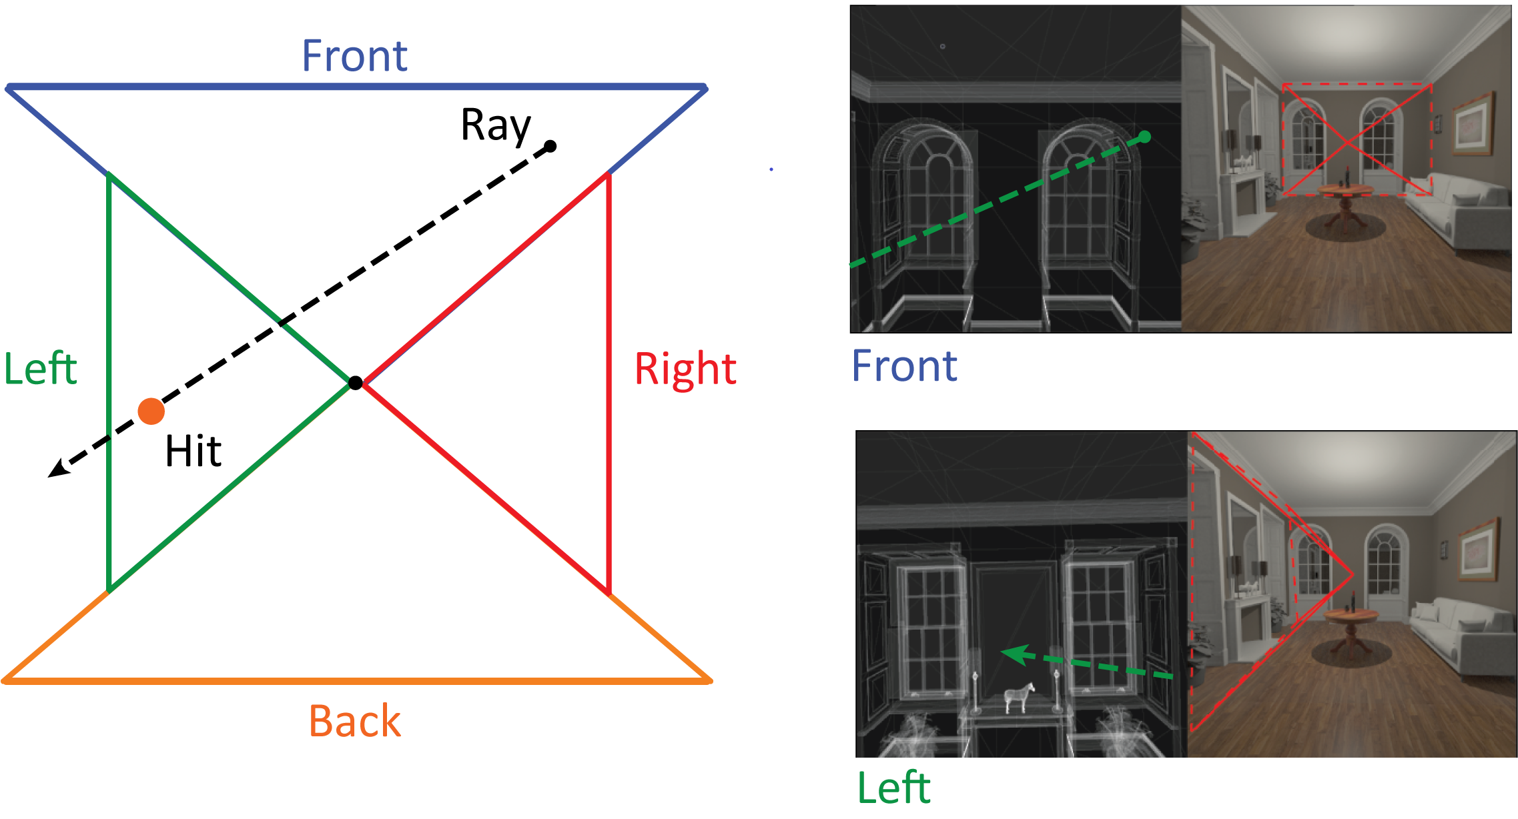
Deferred Image-based Ray Tracing (DIRT) [VVP16]
32
Notes:
Most recently, Vardis et al., introduced a ray tracing architecture, named as DIRT, that exploits the aforementioned spatial subdivision to accurately resolve potential triangle intersections.
Briefly speaking, they used a hierarchical image space traversal algorithm to efficiently march rays across the views of the cubemap and index the actual geometry by iterating a per-pixel storage scheme.

Slide 33
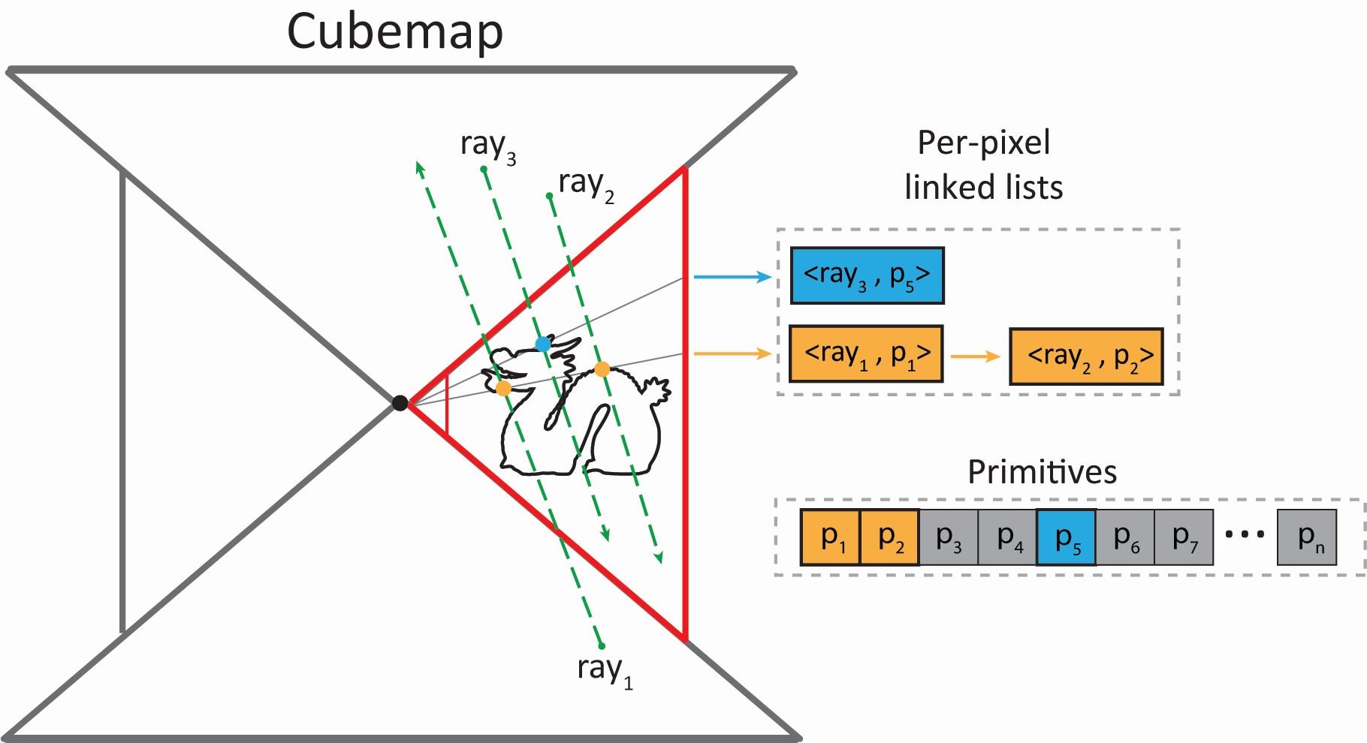
Deferred Image-based Ray Tracing (DIRT) [VVP16]
33
Notes:
In order to perform shading and keep tracing rays at arbitrary depth, their method maintained a per-pixel hit-buffer that recorded the ids of intersected primitives.
In a secondary step, geometry was rasterized into the cubemap to extract the shading data for each intersection and update the payloads of the corresponding to rays.

Slide 34
Method Overview
34
Notes:
Using DIRT as the ray tracing architecture, we can now further proceed to the specific steps of our algorithm.

Slide 35
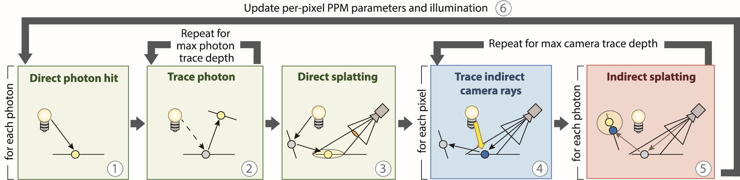
Method Overview
Initialise photon buffer
35
Notes:
First we begin with the photon emission stage. A linear buffer with entries equal to the number of emitted photons times the maximum trace depth is initialized.
Next, the photon tracing pass is invoked. For each photon, an additional path segment is traced along with an update of the corresponding photon entry.
Optionally, in this step, certain types of light emitters, such as point lights, can utilize the rasterizer to employ a fast direct photon bounce, effectively omitting a tracing step.

Slide 36
Method Overview
Initialise photon buffer
Trace photons with DIRT
36
Notes:
First we begin with the photon emission stage. A linear buffer with entries equal to the number of emitted photons times the maximum trace depth is initialized.
Next, the photon tracing pass is invoked. For each photon, an additional path segment is traced along with an update of the corresponding photon entry.
Optionally, in this step, certain types of light emitters, such as point lights, can utilize the rasterizer to employ a fast direct photon bounce, effectively omitting a tracing step.

Slide 37
Method Overview
Initialise photon buffer
Trace photons with DIRT
Update photon parameters
37
Notes:
First we begin with the photon emission stage. A linear buffer with entries equal to the number of emitted photons times the maximum trace depth is initialized.
Next, the photon tracing pass is invoked. For each photon, an additional path segment is traced along with an update of the corresponding photon entry.
Optionally, in this step, certain types of light emitters, such as point lights, can utilize the rasterizer to employ a fast direct photon bounce, effectively omitting a tracing step.

Slide 38
Method Overview
Initialise photon buffer
Trace photons with DIRT
Update photon parameters
Store direct hits in photon buffer (optional)
38
Notes:
First we begin with the photon emission stage. A linear buffer with entries equal to the number of emitted photons times the maximum trace depth is initialized.
Next, the photon tracing pass is invoked. For each photon, an additional path segment is traced along with an update of the corresponding photon entry.
Optionally, in this step, certain types of light emitters, such as point lights, can utilize the rasterizer to employ a fast direct photon bounce, effectively omitting a tracing step.

Slide 39
Method Overview
Initialise photon buffer
Trace photons with DIRT
Update photon parameters
Store direct hits in photon buffer (optional)
39
Notes:
This stage is terminated when the maximum trace depth or a path termination event is encountered by every emitted photon.

Slide 40
Method Overview
40
Notes:
After the photon tracing phase, we can partially evaluate the indirect illumination, visible from the eye sensor on diffuse surfaces. This can be accomplished with the splatting operation on surface points directly visible from the camera.

Slide 41
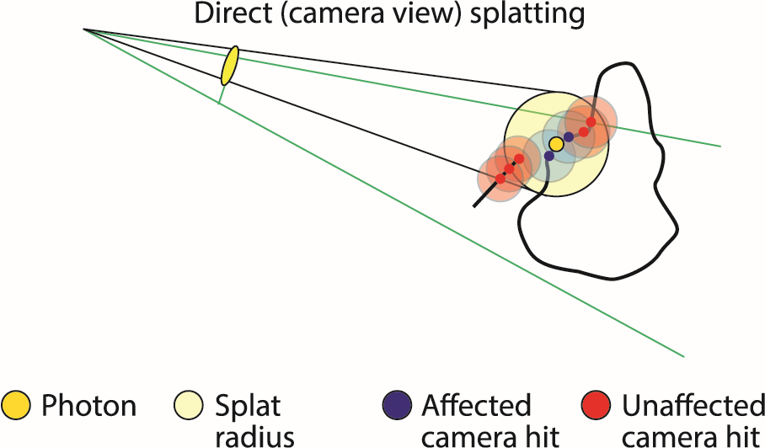
Method Overview
Splat indirect-only photons
41
Notes:
More specifically, every indirectly scattered photon can be treated as a primitive and rasterized on the camera image plane with splat size equal to the importon gathering radius.
Generated fragments will index and accumulate photon energy contributions using the camera G-buffer. Due to the inherent parallelization provided by the rasterization, this method effectively replaces a tree search invocation with a constant time indexing mechanism.

Slide 42
Method Overview
Splat indirect-only photons
Splat size is equal to density estimation radius
42
Notes:
More specifically, every indirectly scattered photon can be treated as a primitive and rasterized on the camera image plane with splat size equal to the importon gathering radius.
Generated fragments will index and accumulate photon energy contributions using the camera G-buffer. Due to the inherent parallelization provided by the rasterization, this method effectively replaces a tree search invocation with a constant time indexing mechanism.

Slide 43
Method Overview
Splat indirect-only photons
Splat size is equal to density estimation radius
Accumulate photon contributions using G-buffer
43
Notes:
More specifically, every indirectly scattered photon can be treated as a primitive and rasterized on the camera image plane with splat size equal to the importon gathering radius.
Generated fragments will index and accumulate photon energy contributions using the camera G-buffer. Due to the inherent parallelization provided by the rasterization, this method effectively replaces a tree search invocation with a constant time indexing mechanism.

Slide 44
Method Overview
44
Notes:
Up to this step, we have only recorded the contribution of photons using only the light tracing step. Since gathering can only occur on diffuse surfaces, we have demonstrated how to evaluate part of the final indirect illumination.

Slide 45
Method Overview
Completed paths of the form L(S|G|D)*DE
45
Notes:
Up to this step, we have only recorded the contribution of photons using only the light tracing step. Since gathering can only occur on diffuse surfaces, we have demonstrated how to evaluate part of the final indirect illumination.

Slide 46
Method Overview
Completed paths of the form L(S|G|D)*DE
Missing specular/glossy paths of the form LD(S|G)+E
46
Notes:
This accounts for path segments that does not include specular or highly glossy events that are directly visible from the camera.

Slide 47
Method Overview
Completed paths of the form L(S|G|D)*DE
Missing specular/glossy paths of the form LD(S|G)+E
Trace importons from specular/glossy surfaces
47
Notes:
Thus, secondary paths must be traced from the camera to capture these events and terminate on diffuse surfaces in order to effectively enable the gathering process.

Slide 48
Method Overview
Completed paths of the form L(S|G|D)*DE
Missing specular/glossy paths of the form LD(S|G)+E
Trace importons from specular/glossy surfaces
Importon hits are implicitly recorded in the hit-buffer
48
Notes:
Since we use the DIRT to trace the importons, successful surface intersections are implicitly recorded from its hit-buffer and as a result spatial information is preserved.
Therefore, no further modification or extra storage mechanism is required.

Slide 49
Method Overview
Access importons of current trace depth
49
Notes:
Active importon hits, for the current trace depth, can now be indexed by splatting indirectly scattered photons into the DIRT cubemap.

Slide 50
Method Overview
Access importons of current trace depth
Splat indirect photons to DIRT-cubemap
50
Notes:
Active importon hits, for the current trace depth, can now be indexed by splatting indirectly scattered photons into the DIRT cubemap.

Slide 51
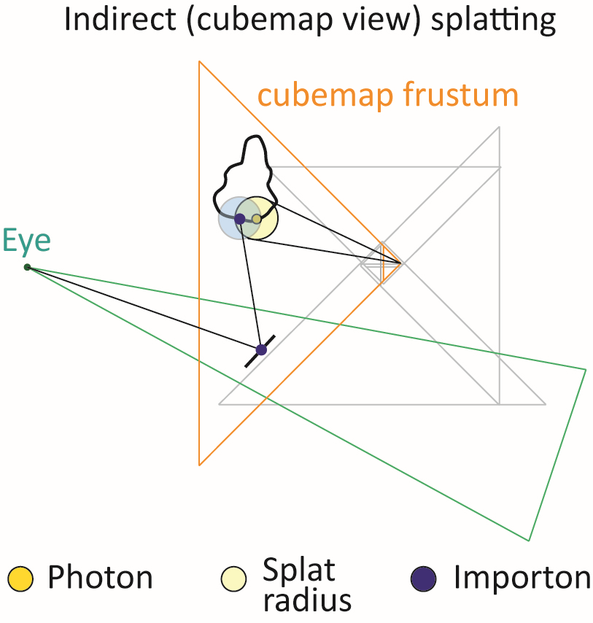
Method Overview
Access importons of current trace depth
Splat indirect photons to DIRT-cubemap
Importons may not be visible after secondary bounce
51
Notes:
This is a necessary operation as importons may not be directly visible after the secondary bounce.
Nevertheless, photon splat projections are independent of the cubemap resolution and therefore, does not introduce any approximations to the final flux distribution since this parameter only affects the sparsity and the length of the hit records.

Slide 52
Method Overview
Access importons of current trace depth
Splat indirect photons to DIRT-cubemap
Importons may not be visible after secondary bounce
Projected splat is independent of cubemap resolution
52
Notes:
This is a necessary operation as importons may not be directly visible after the secondary bounce.
Nevertheless, photon splat projections are independent of the cubemap resolution and therefore, does not introduce any approximations to the final flux distribution since this parameter only affects the sparsity and the length of the hit records.

Slide 53
Method Overview
Access importons of current trace depth
Splat indirect photons to DIRT-cubemap
Importons may not be visible after secondary bounce
Projected splat is independent of cubemap resolution
53
Notes:
Repeating theses 2 stages until a diffuse event or a maximum depth is reached, will be sufficient to completely simulate every missing illumination path.

Slide 54
Method Overview
Compute direct illumination
Average final illumination result
54
Notes:
Finally, accumulating direct illumination and averaging the final rendering output will complete a single iteration of our photon mapper.
This concludes our proposed method.

Slide 55
Method Evaluation
55
Notes:
For the evaluation part, we performed experiments on 7 different scenes with geometry complexity from a few thousand to over a million triangles.
As for the photon emission size we employ batches of approximately 250 thousand photons for each case.

Slide 56
Method Evaluation
10K - 1.2M triangles
batches of ~250K photons
56
Notes:
For the evaluation part, we performed experiments on 7 different scenes with geometry complexity from a few thousand to over a million triangles.
As for the photon emission size we employ batches of approximately 250 thousand photons for each case.

Slide 57
Method Evaluation
10K - 1.2M triangles
batches of ~250K photons
NVIDIA OptiX [PDB+10]
CUDA FLANN kd-tree [ML09]
NVIDIA RTX 2080 Ti 11GB
57
Notes:
Now in order to compare the performance and quality of our method we implemented a reference probabilistic progressive photon mapper with Optix ray tracer and FLANN kd-tree a cuda accelerated library for nearest neighbors searches.
And for both implementations we used an NVIDIA RTX 2080.

Slide 58
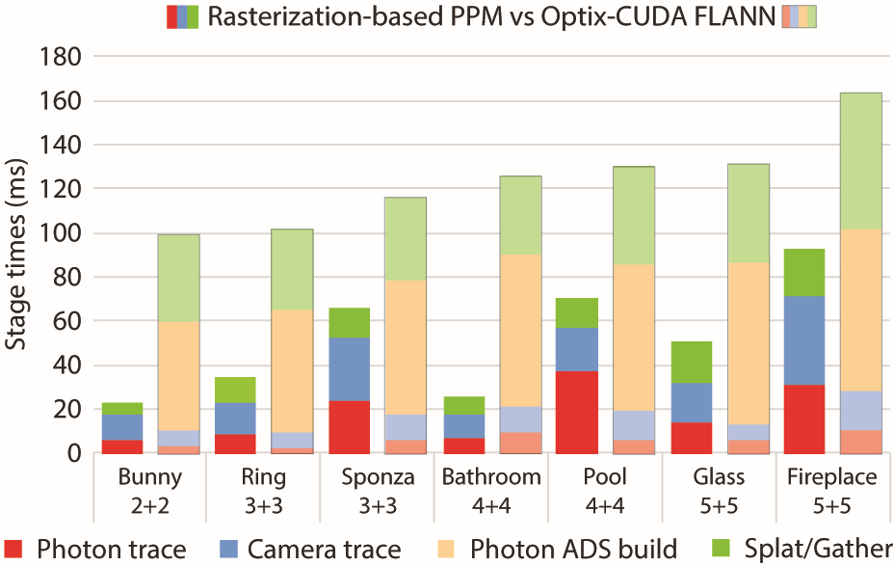
Method Evaluation - Performance
58
Notes:
First, we illustrate for each test case, with variable size of light and eye path lengths an average time for a complete iteration of the photon mapping process. As we can observe, despite the comparatively slower ray traversal of DIRT compared to the optimized OptiX ray tracing engine our method has a significantly better overall performance due to two important factors. First, our photon mapping variant does not require any photon ADS construction. Second, the introduction of photon splatting instead of gathering at all path depths, outperforms a tree search operation due to its trivially parallel fragment-based execution.

Slide 59
Method Evaluation - Performance
59
Notes:
First, we illustrate for each test case, with variable size of light and eye path lengths an average time for a complete iteration of the photon mapping process. As we can observe, despite the comparatively slower ray traversal of DIRT compared to the optimized OptiX ray tracing engine our method has a significantly better overall performance due to two important factors. First, our photon mapping variant does not require any photon ADS construction. Second, the introduction of photon splatting instead of gathering at all path depths, outperforms a tree search operation due to its trivially parallel fragment-based execution.

Slide 60
Method Evaluation - Performance
60
Notes:
First, we illustrate for each test case, with variable size of light and eye path lengths an average time for a complete iteration of the photon mapping process. As we can observe, despite the comparatively slower ray traversal of DIRT compared to the optimized OptiX ray tracing engine our method has a significantly better overall performance due to two important factors. First, our photon mapping variant does not require any photon ADS construction. Second, the introduction of photon splatting instead of gathering at all path depths, outperforms a tree search operation due to its trivially parallel fragment-based execution.

Slide 61
Method Evaluation - Performance
61
Notes:
First, we illustrate for each test case, with variable size of light and eye path lengths an average time for a complete iteration of the photon mapping process. As we can observe, despite the comparatively slower ray traversal of DIRT compared to the optimized OptiX ray tracing engine our method has a significantly better overall performance due to two important factors. First, our photon mapping variant does not require any photon ADS construction. Second, the introduction of photon splatting instead of gathering at all path depths, outperforms a tree search operation due to its trivially parallel fragment-based execution.

Slide 62
Method Evaluation - Performance
62
Notes:
First, we illustrate for each test case, with variable size of light and eye path lengths an average time for a complete iteration of the photon mapping process. As we can observe, despite the comparatively slower ray traversal of DIRT compared to the optimized OptiX ray tracing engine our method has a significantly better overall performance due to two important factors. First, our photon mapping variant does not require any photon ADS construction. Second, the introduction of photon splatting instead of gathering at all path depths, outperforms a tree search operation due to its trivially parallel fragment-based execution.

Slide 63
Method Evaluation - Performance
~ 2-3X faster!
63
Notes:
First, we illustrate for each test case, with variable size of light and eye path lengths an average time for a complete iteration of the photon mapping process. As we can observe, despite the comparatively slower ray traversal of DIRT compared to the optimized OptiX ray tracing engine our method has a significantly better overall performance due to two important factors. First, our photon mapping variant does not require any photon ADS construction. Second, the introduction of photon splatting instead of gathering at all path depths, outperforms a tree search operation due to its trivially parallel fragment-based execution.

Slide 64
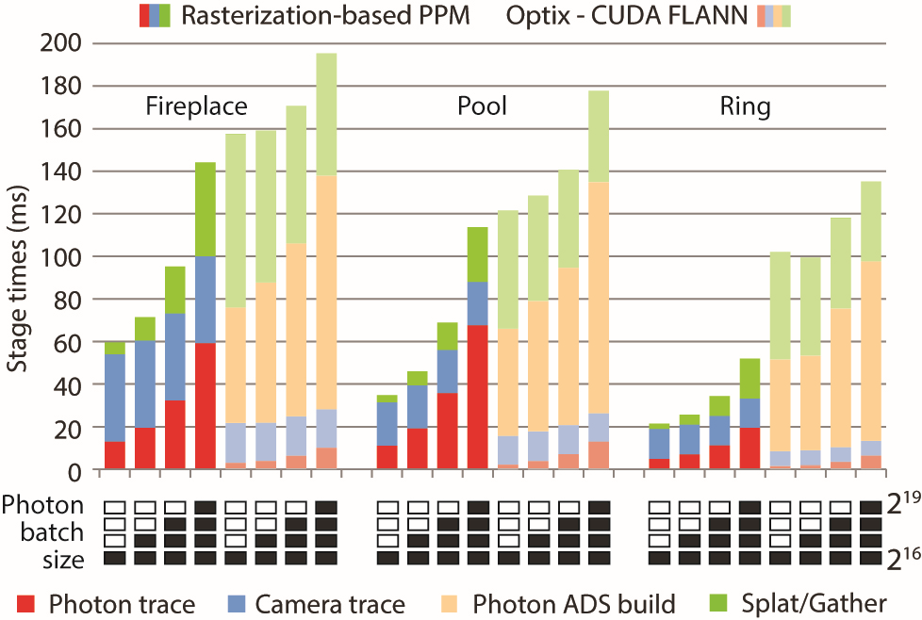
Method Evaluation - Performance
~500K
~60K
64
Notes:
Next, we investigate the performance impact induced as the emitted batch size varies from approximately 60 thousand to 500 thousand photons for both methods. Despite that image-space photon tracing takes a significant portion of time for a single photon mapping cycle, FLANN ADS construction and indexing has a considerable overhead resulting in noticeably higher cycle times in all cases.

Slide 65
Method Evaluation - Performance
~ 2-3X faster!
~500K
~60K
65
Notes:
Next, we investigate the performance impact induced as the emitted batch size varies from approximately 60 thousand to 500 thousand photons for both methods. Despite that image-space photon tracing takes a significant portion of time for a single photon mapping cycle, FLANN ADS construction and indexing has a considerable overhead resulting in noticeably higher cycle times in all cases.

Slide 66
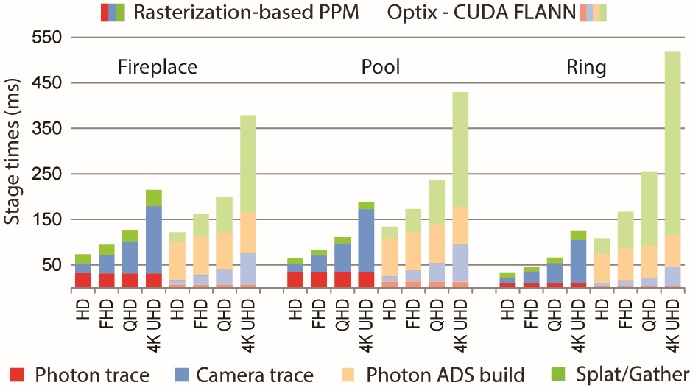
Method Evaluation - Performance
66
Notes:
We aslo investigate the performance impact of both methods with different resolutions up to 4K with constant photon emitted batch size. The same behavior is observed as image-space importon tracing is heavily affected by the increasing resolution. Nevertheless, the overhead induced primarily by the queries of the FLANN kd-tree overshadows our method’s total cycle time.

Slide 67
Method Evaluation - Performance
~ 2-4X faster!
67
Notes:
We aslo investigate the performance impact of both methods with different resolutions up to 4K with constant photon emitted batch size. The same behavior is observed as image-space importon tracing is heavily affected by the increasing resolution. Nevertheless, the overhead induced primarily by the queries of the FLANN kd-tree overshadows our method’s total cycle time.

Slide 68
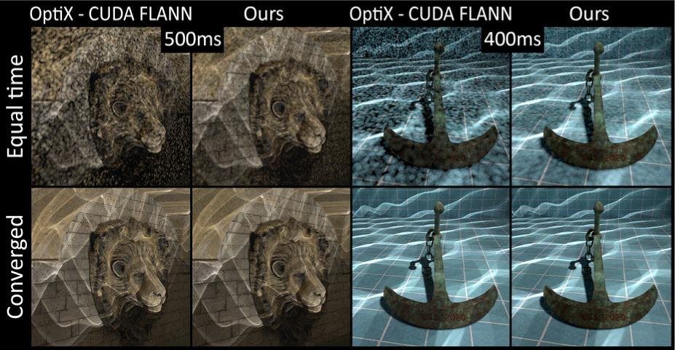
Method Evaluation - Quality
68
Notes:
Furthermore, we show example renderings, demonstrating the higher image quality that our method delivers for equal time comparisons.

Slide 69
Method Evaluation - Quality
69
Notes:
Morever, since we employ analytical ray intersection tests combined with accurate photon energy distribution through the splatting operation,
we can guarantee that the final result is consistent with the reference method.

Slide 70

Method Evaluation
70
Notes:
Finally, we would like to briefly demonstrate the interactive aspect of our method on two example scenes.

Slide 71
Conclusion
71
Notes:
Concluding this talk, we have presented an accurate probabilistic progressive photon mapper for the rasterization pipeline.
By exploiting the parallel capabilities of the available hardware, the splatting operation in conjunction with the implicit handle of the importon storage from DIRT can be used as an efficient alternative for the gathering process.This effectively eliminates the photon map hierarchy and at the same time is capable of capturing every illumination event.

Slide 72
Conclusion
Porting of PPM to the rasterization pipeline
72
Notes:
Concluding this talk, we have presented an accurate probabilistic progressive photon mapper for the rasterization pipeline.
By exploiting the parallel capabilities of the available hardware, the splatting operation in conjunction with the implicit handle of the importon storage from DIRT can be used as an efficient alternative for the gathering process.This effectively eliminates the photon map hierarchy and at the same time is capable of capturing every illumination event.

Slide 73
Conclusion
Porting of PPM to the rasterization pipeline
Exploitation of the hardware accelerated splatting operation
73
Notes:
Concluding this talk, we have presented an accurate probabilistic progressive photon mapper for the rasterization pipeline.
By exploiting the parallel capabilities of the available hardware, the splatting operation in conjunction with the implicit handle of the importon storage from DIRT can be used as an efficient alternative for the gathering process.This effectively eliminates the photon map hierarchy and at the same time is capable of capturing every illumination event.

Slide 74
Conclusion
Porting of PPM to the rasterization pipeline
Exploitation of the hardware accelerated splatting operation
A unified data structure for tracing and gathering
74
Notes:
Concluding this talk, we have presented an accurate probabilistic progressive photon mapper for the rasterization pipeline.
By exploiting the parallel capabilities of the available hardware, the splatting operation in conjunction with the implicit handle of the importon storage from DIRT can be used as an efficient alternative for the gathering process.This effectively eliminates the photon map hierarchy and at the same time is capable of capturing every illumination event.

Slide 75
Conclusion
Porting of PPM to the rasterization pipeline
Exploitation of the hardware accelerated splatting operation
A unified data structure for tracing and gathering
Elimination of the photon map hierarchy
75
Notes:
Concluding this talk, we have presented an accurate probabilistic progressive photon mapper for the rasterization pipeline.
By exploiting the parallel capabilities of the available hardware, the splatting operation in conjunction with the implicit handle of the importon storage from DIRT can be used as an efficient alternative for the gathering process.This effectively eliminates the photon map hierarchy and at the same time is capable of capturing every illumination event.

Slide 76
Conclusion
Porting of PPM to the rasterization pipeline
Exploitation of the hardware accelerated splatting operation
A unified data structure for tracing and gathering
Elimination of the photon map hierarchy
The benefits of the method rely heavily on the specifics of the DIRT method
76
Notes:
Nevertheless, theses benefits come at some cost. As demonstrated, indirect splatting performance is directly dependent on DIRT specific parameters. Which is also the case for the overall tracing performance.

Slide 77
Questions
Source code and demos related to this work can be found at our group’s
public repository:
https://github.com/cgaueb/MFR
downloads page:
http://graphics.cs.aueb.gr/graphics/downloads.html
http://graphics.cs.aueb.gr/
77

Slide 78
References
[Jen96] Jensen, H. W.: Global Illumination Using Photon Maps. Eurographics Workshop on Rendering Techniques 1996.
[HOJ08] Hachisuka, T., Ogaki, S., Jensen, H. W.: Progressive Photon Mapping. ACM Trans. Graph. 2008.
[HJ09] Hachisuka, T., Jensen, H. W.: Stochastic Progressive Photon Mapping. ACM Trans. Graph. 2009.
[KZ11] Knaus, C., Zwicker, M.: Progressive Photon Mapping: A Probabilistic Approach. ACM Trans. Graph. 2011.
[ML09] Muja, M., Andlowe, D. G.: Fast Approximate Nearest Neighbors with Automatic Algorithm Configuration. VISAPP 2009.
[PBD+10] Parker, S. G.,et al.: Optix: A general purpose ray tracing engine. ACM Trans. Graph. 2011.
[VVP16] Vardis, K., Vasilakis, A. A., Papaioannou, G.: DIRT: Deferred Image-based Ray Tracing. HPG 2016.
[VVP20] Vasilakis, A. A., Vardis, K., Papaioannou, G.: A Survey of Multifragment Rendering. EG STAR 2020.
78
MUJA, M.,ANDLOWE, D. G. 2009. Fast Approximate Nearest Neighbors with AutomaticAlgorithm Configuration. InVISAPP International Conference on Computer Vision Theoryand Applications

